Slide 1


MovieMatrixDB
-KALPESH ATTARDE

Slide 2











MovieMatrixDB
Abstract
MovieMatrixDB is a database built to help you organize and explore movies, TV series, web series, and TV shows.
Each title comes with its main genre, category, and lead actor, and users can share ratings and reviews.
With this setup, you can run powerful SQL queries to discover trend like what people love watching, which genres are getting top scores, and how user opinions differ.
It’s a flexible system that makes media analytics and recommendations easy and insightful.

Slide 3
MovieMatrixDB
Key Questions
Which titles have an average user rating above the overall average rating?
What are the number of titles and average IMDb ratings for each content category (movies, TV series, etc.)?
What are the top-rated titles based on user ratings?
Which genres receive the highest average IMDb ratings?
Who are the most active users in terms of rating submissions?
What is the distribution of user ratings — e.g., users rating titles highly (≥7.5)?
How do genre preferences correlate with user ratings and IMDb scores?
Are there specific actors whose films consistently get higher ratings?
How does user engagement vary across different categories and genres?
Which titles have the highest and lowest user ratings and what patterns emerge?

Slide 4

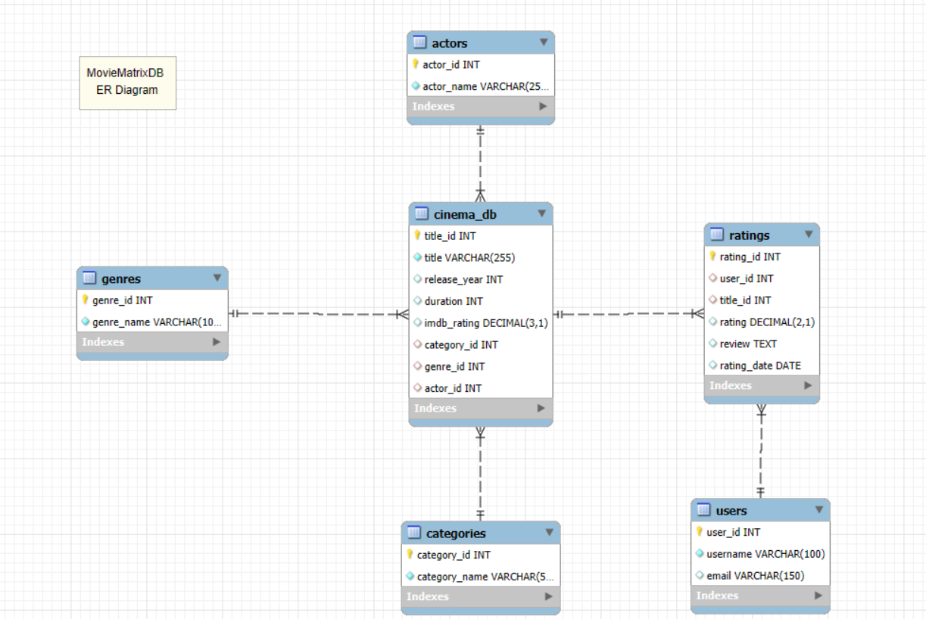
ER-Diagram
MovieMatrixDB

Slide 5

MovieMatrixDB
Structure of the tables

Slide 6
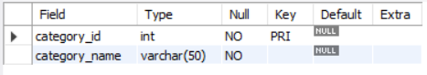
Categories table
MovieMatrixDB
SYNTAX:-
CREATE TABLE categories (
category_id INT PRIMARY KEY,
category_name VARCHAR(50) NOT NULL
);

Slide 7
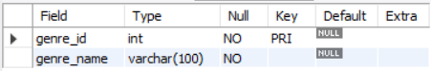
genres table
MovieMatrixDB
SYNTAX:-
CREATE TABLE genres (
genre_id INT PRIMARY KEY,
genre_name VARCHAR(100) NOT NULL
);

Slide 8
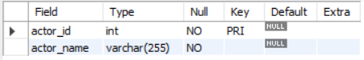
Actors table
MovieMatrixDB
SYNTAX:-
CREATE TABLE actors (
actor_id INT PRIMARY KEY,
actor_name VARCHAR(255) NOT NULL
);

Slide 9
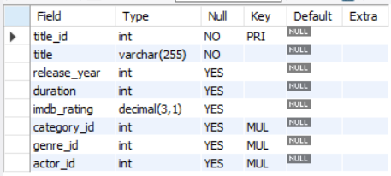
cinema_DB table
MovieMatrixDB
SYNTAX:-
CREATE TABLE cinema_db (
title_id INT PRIMARY KEY,
title VARCHAR(255) NOT NULL,
release_year INT,
duration INT,
imdb_rating DECIMAL(3,1),
category_id INT,
genre_id INT,
actor_id INT,
FOREIGN KEY (category_id)
REFERENCES categories(category_id),
FOREIGN KEY (genre_id)
REFERENCES genres(genre_id),
FOREIGN KEY (actor_id)
REFERENCES actors(actor_id)
);

Slide 10
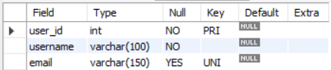
USERs table
MovieMatrixDB
SYNTAX:-
CREATE TABLE users (
user_id INT PRIMARY KEY,
username VARCHAR(100) NOT NULL,
email VARCHAR(150) UNIQUE
);

Slide 11
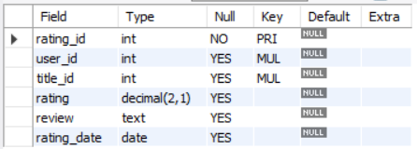
Ratings table
MovieMatrixDB
SYNTAX:-
CREATE TABLE ratings (
rating_id INT PRIMARY KEY,
user_id INT,
title_id INT,
rating DECIMAL(2,1)
CHECK (rating BETWEEN 0 AND 10),
review TEXT,
rating_date DATE,
FOREIGN KEY (user_id)
REFERENCES users (user_id),
FOREIGN KEY (title_id)
REFERENCES cinema_db (title_id)
);

Slide 12
MovieMatrixDB
Contents of the tables

Slide 13
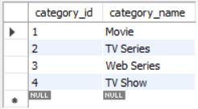
Categories table
MovieMatrixDB

Slide 14
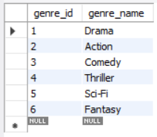
genres table
MovieMatrixDB

Slide 15
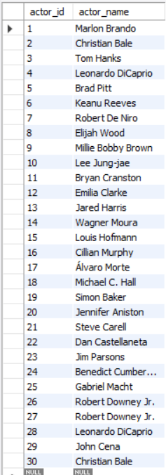
Actors table
MovieMatrixDB

Slide 16
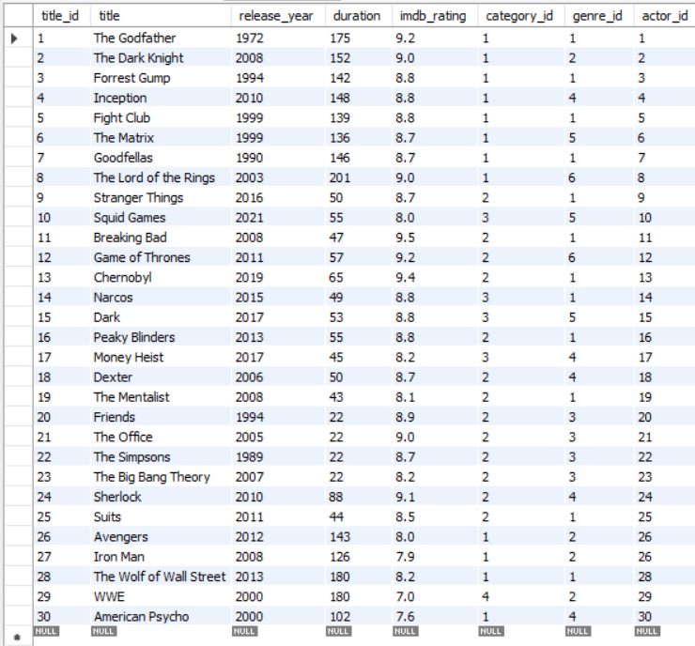
cinema_DB table
MovieMatrixDB

Slide 17
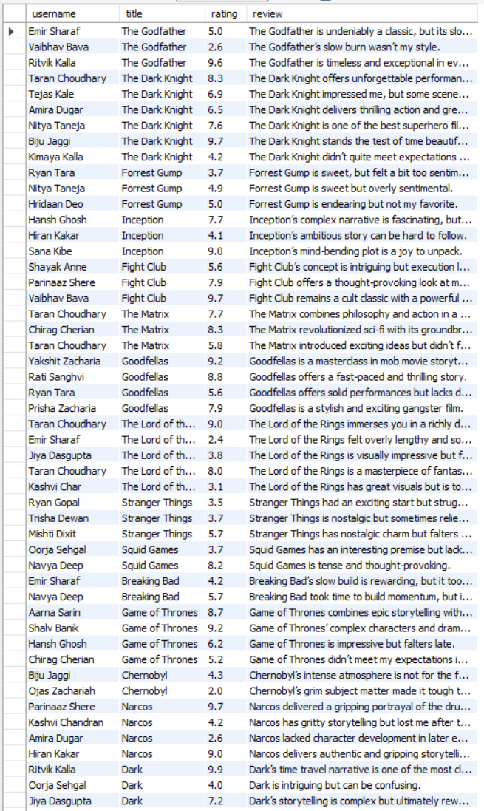
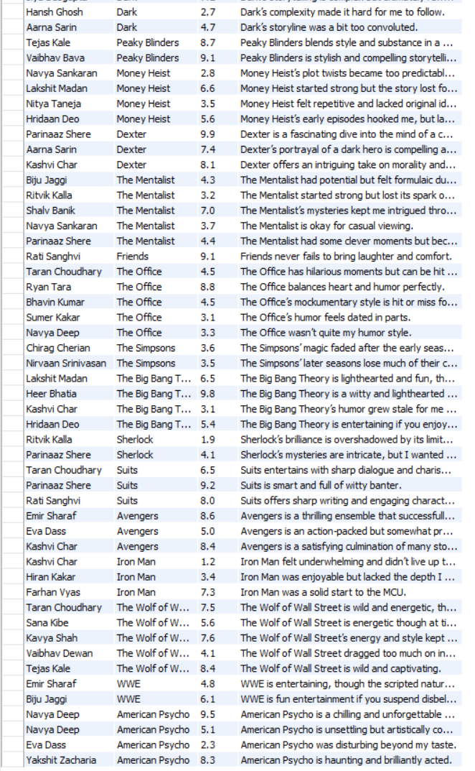
USERs table
MovieMatrixDB

Slide 18
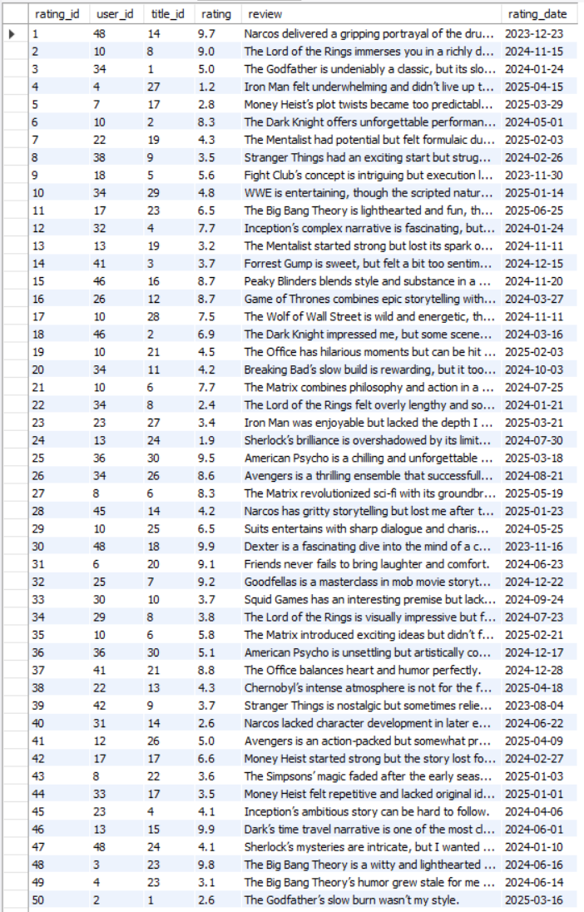
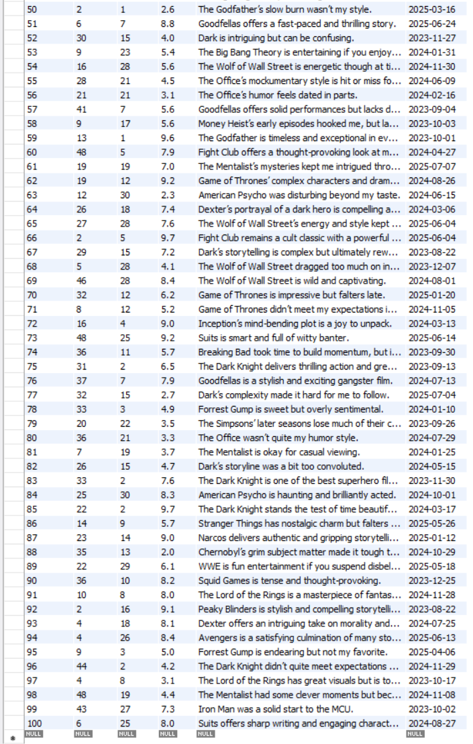
Ratings table
MovieMatrixDB

Slide 19
MovieMatrixDB
Subqueries

Slide 20
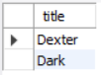
Q.1.1 Titles with ratings
above overall average rating
MovieMatrixDB
SYNTAX:-
SELECT title
FROM cinema_db
WHERE title_id IN (
SELECT title_id
FROM ratings
WHERE rating > (SELECT AVG(rating)
FROM ratings)
);

Slide 21
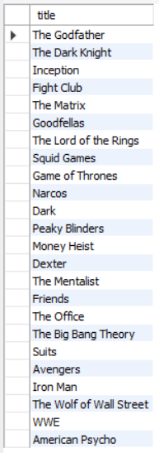
Q.1.2 FIND Titles that received
the highest rating by any user.
MovieMatrixDB
SYNTAX:-
SELECT title
FROM cinema_db
WHERE title_id IN (
SELECT title_id
FROM ratings
WHERE rating = (SELECT MAX(rating)
FROM ratings)
);

Slide 22
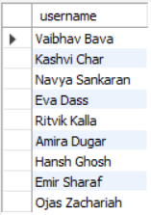
Q.1.3 FIND Users who gave
any rating below 3.
MovieMatrixDB
SYNTAX:-
SELECT username
FROM users
WHERE user_id IN (
SELECT user_id FROM ratings
WHERE rating < 3
);

Slide 23
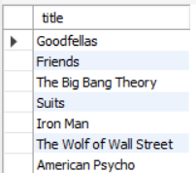
Q.1.4 FIND Titles rated by users
who only gave ratings above 7.
MovieMatrixDB
SYNTAX:-
SELECT title
FROM cinema_db
WHERE title_id IN (
SELECT DISTINCT title_id
FROM ratings
WHERE user_id IN (
SELECT user_id FROM ratings
GROUP BY user_id
HAVING MIN(rating) > 7
)
);

Slide 24
Q.1.5 Titles that share
the same genre as 'Inception'
MovieMatrixDB
SYNTAX:-
SELECT title
FROM cinema_db
WHERE genre_id = (
SELECT genre_id
FROM cinema_db
WHERE title = 'Inception'
);

Slide 25
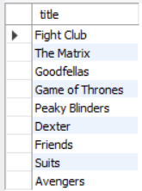
Q.1.6 Titles that share
the same genre as 'Inception'
MovieMatrixDB
SYNTAX:-
SELECT title
FROM cinema_db
WHERE title_id IN (
SELECT title_id
FROM ratings
GROUP BY title_id
HAVING MIN(rating) >= 5
);

Slide 26
MovieMatrixDB
Joins

Slide 27
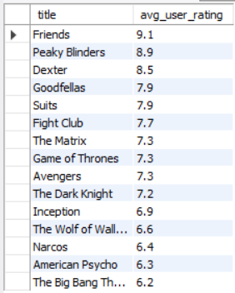
Q.2.1 Find titles with average rating
above the overall average rating.
MovieMatrixDB
SYNTAX:-
SELECT
c.title,
ROUND(AVG(r.rating),1) AS avg_user_rating
FROM cinema_db c
JOIN ratings r
ON c.title_id = r.title_id
GROUP BY c.title
HAVING AVG(r.rating) > (SELECT AVG(rating)
FROM ratings)
ORDER BY avg_user_rating DESC;

Slide 28
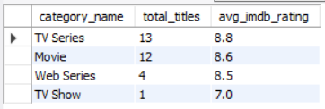
Q.2.2 Find Number of titles per category and their
average IMDb rating.
MovieMatrixDB
SYNTAX:-
SELECT cat.category_name,
COUNT(c.title_id) AS total_titles,
ROUND(AVG(c.imdb_rating),1)
AS avg_imdb_rating
FROM categories cat
JOIN cinema_db c
ON cat.category_id = c.category_id
GROUP BY cat.category_name
ORDER BY total_titles DESC;

Slide 29
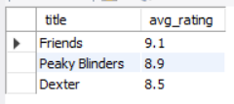
Q.2.3 Top 3 titles by
average user rating.
MovieMatrixDB
SYNTAX:-
SELECT c.title,
ROUND(AVG(r.rating),1) AS avg_rating
FROM cinema_db c
JOIN ratings r ON c.title_id = r.title_id
GROUP BY c.title
ORDER BY avg_rating DESC
LIMIT 3;

Slide 30
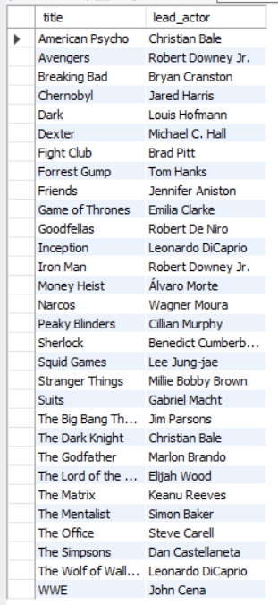
Q.2.4 List all titles along
with their lead actor.
MovieMatrixDB
SYNTAX:-
SELECT
c.title,
a.actor_name AS lead_actor
FROM cinema_db c
JOIN actors a
ON c.actor_id = a.actor_id
ORDER BY c.title;

Slide 31
MovieMatrixDB
Joins+Subqueries

Slide 32
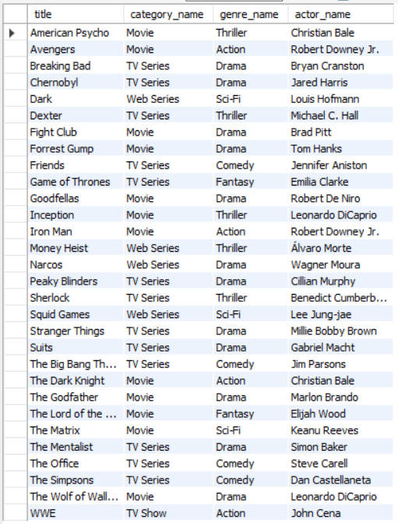
Q.3.1 List all titles with their
category, genre, and actor.
MovieMatrixDB
SYNTAX:-
SELECT c.title,
cat.category_name,
g.genre_name,
a.actor_name
FROM cinema_db c
JOIN categories cat
ON c.category_id = cat.category_id
JOIN genres g
ON c.genre_id = g.genre_id
JOIN actors a
ON c.actor_id = a.actor_id
ORDER BY c.title;

Slide 33
Q.3.2 Get all ratings along
with username and title names.
MovieMatrixDB
SYNTAX:-
SELECT
u.username,
c.title,
r.rating,
r.review
FROM ratings r
JOIN users u
ON r.user_id = u.user_id
JOIN cinema_db c
ON r.title_id = c.title_id;

Slide 34
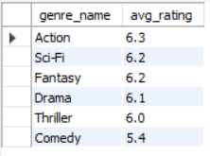
Q.3.3 Get average rating
per genre.
MovieMatrixDB
SYNTAX:-
SELECT
g.genre_name,
ROUND(AVG(r.rating), 1) AS avg_rating
FROM ratings r
JOIN cinema_db c ON r.title_id = c.title_id
JOIN genres g ON c.genre_id = g.genre_id
GROUP BY g.genre_name
ORDER BY avg_rating DESC;

Slide 35
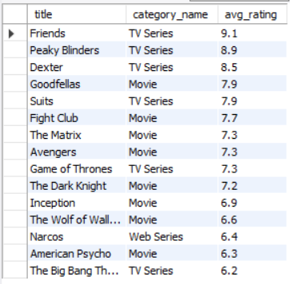
Q.3.4 List titles where average rating is
above overall average rating, including category name.
MovieMatrixDB
SYNTAX:-
SELECT
c.title,
cat.category_name,
ROUND(AVG(r.rating),1) AS avg_rating
FROM cinema_db c
JOIN ratings r ON c.title_id = r.title_id
JOIN categories cat
ON c.category_id = cat.category_id
GROUP BY c.title, cat.category_name
HAVING AVG(r.rating) > (SELECT AVG(rating)
FROM ratings)
ORDER BY avg_rating DESC;

Slide 36
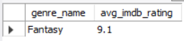
Q.3.5 Find the genre
with the highest average IMDb rating.
MovieMatrixDB
SYNTAX:-
SELECT
g.genre_name,
ROUND(AVG(c.imdb_rating),1)
AS avg_imdb_rating
FROM genres g
JOIN cinema_db c
ON g.genre_id = c.genre_id
GROUP BY g.genre_name
ORDER BY avg_imdb_rating DESC
LIMIT 1;

Slide 37
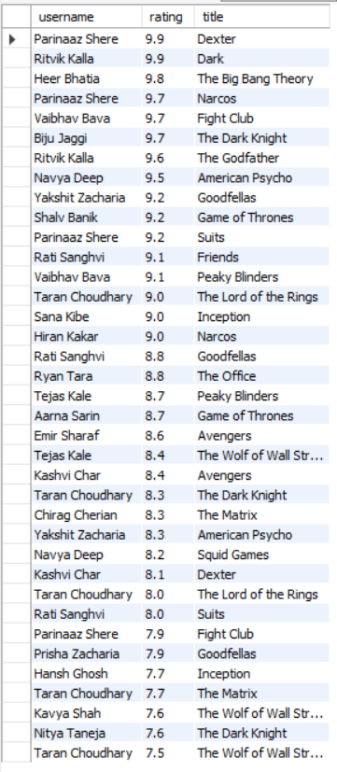
Q.3.6 List users who
rated 7.5 or more to any title.
MovieMatrixDB
SYNTAX:-
SELECT DISTINCT
u.username,
r.rating,
c.title
FROM ratings r
JOIN users u ON r.user_id = u.user_id
JOIN cinema_db c ON r.title_id = c.title_id
WHERE r.rating >= 7.5
ORDER BY r.rating DESC;

Slide 38
MovieMatrixDB
Insights
A subset of titles consistently scores above the overall average user rating, indicating user favorites that may warrant further promotion or analysis.
Categories like Movies and TV Series dominate in number of titles, but their average IMDb ratings suggest variability in quality or popularity.
Certain genres, such as Drama and Fantasy, show higher average IMDb ratings, highlighting trends in audience preferences.
Lead actors associated with highly rated titles may influence user ratings, reflecting the impact of star power.
User rating activity is uneven with a few users contributing disproportionately, suggesting opportunities to expand active user base.
Titles with multiple high ratings often have strong engagement and positive reviews, serving as examples for content curation.
User ratings can differ significantly from IMDb ratings, revealing gaps between critical acclaim and user perception.
Some lower-rated titles still maintain niche followings, suggesting deeper segmentation in audience tastes.

Slide 39


MovieMatrixDB
-By kalpesh attarde

